Slide 1


Slide 2


Thank you for attending!
Why are we here?
Learn and practice coding skills
Answer interesting questions
To have fun!
Notes:
Just to give you a little background of why we created PsychHacks, Coding is becoming more of a necessity for social scientists, but is not often taught outside of computer science. Most of us just end up teaching ourselves through hours of google and stack overflow. Our aim for Psychhacks is to provide an opportunity to learn and practice coding in a friendly and collaborative environment.

Slide 3
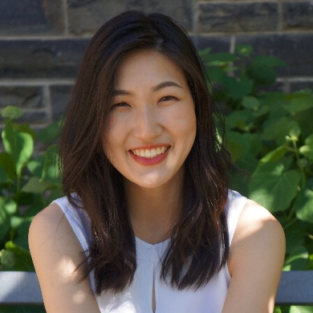
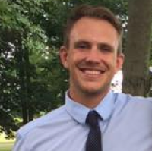
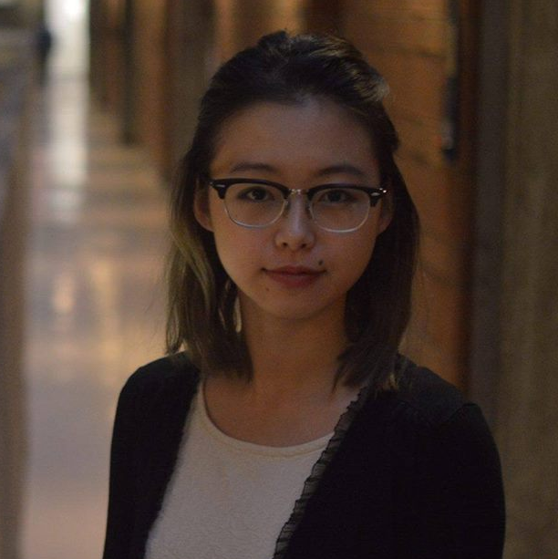
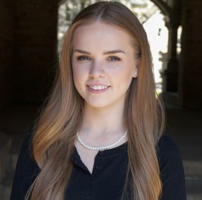
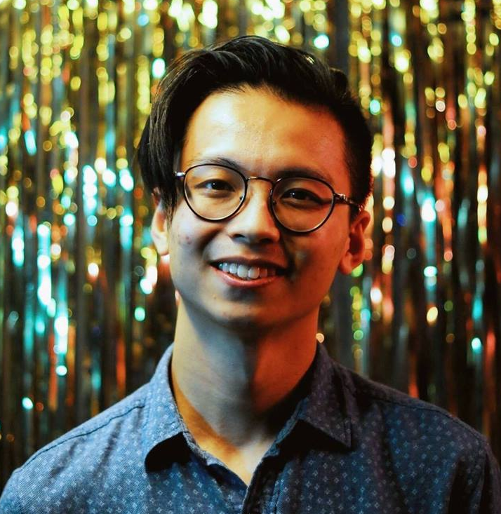
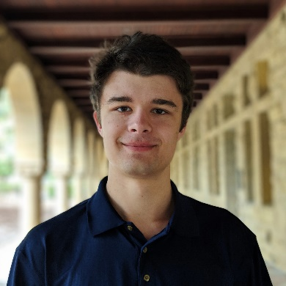
Meet your organizing committee…
Ariana Youm
Kyle Nealy
Annabel Fan
Rachel Forbes
Bryan Hong
Alex Gordienko

Slide 4
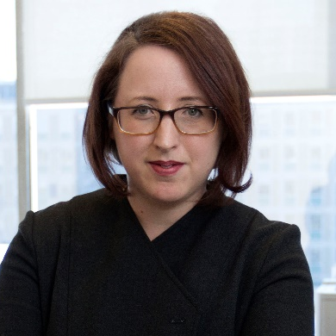
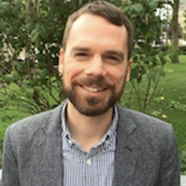



Special thank you to…
Dr. Katherine Duncan
Dr. Michael Mack

Slide 5





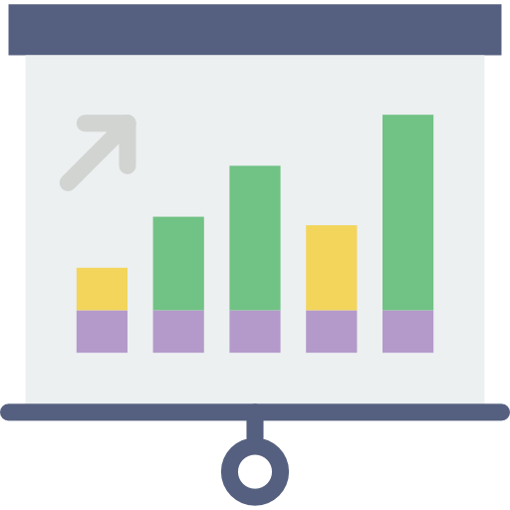
What are we doing?
1
Come up with
research questions
Form your teams
2
Get a dataset
3
Solve those
questions!
4
5
Submit to Github
6
Present your findings!
Notes:
Just to give you an idea of what we’re doing during this event you’ll be coming up with a research question in teams and answering it using one of the datasets we provide or choosing your own. The research question can be whatever your team is interested in, as big or small as you’d like but keep in mind you should aim to complete it in 24h.
During those 24h, you’ll be working at solving those questions as well as finding a way to best present your findings. We’ll be doing the submissions over Github, which we’ll have a fun little icebreaker on shortly. You’ll be sharing your results with everyone at the end of the day tomorrow in a short 5 minute presentation – feel free to be creative in the way you present your data! If you’ve always wanted to make something like a Shiny App or a cool interactive visualization, this is a great opportunity to do so

Slide 6



Judging Criteria
Design and
Discovery
Methods
Execution
10 points
15 points
10 points
Notes:
We’ll be judging the projects based on three categories.
The first is Design and discovery – how creative you are with research question with datasets; scope of research question
The next is
Methods – how rigorous is your solution/does analysis answer your research question
The last is
Execution – how you present and visualize your results, what your team could accomplish in the 24h

Slide 7


Awards
First Prize
Second Prize
$25 Amazon Gift Card
$15 Starbucks Gift Card
Notes:
We have some exciting prizes for the team who comes up with the best solutions – first prize will be a $100 Amazon gift card and second prize will be a $60 dollar starbucks gift card

Slide 8



Datasets
What is your team interested in?
General Social
Survey
VR Spatial
Navigation
Eyetracking
Notes:
We have three datasets we’ve picked out. The first is the general social survey which is a large survey that is conducted over multiple years. It measures demographics, attitudes and behaviors of US citizens.
This dataset contains data collected from healthy young adults on their memory for reward distributions in 3D virtual environments
This dataset contains data about eye movements and pupil size when healthy young adults passively viewed images of faces and then performed a memory test.
There will be more information provided to you on each of these datasets on the Github for you to review later on

Slide 9
Datasets
What is your team interested in?
…or you can choose your own adventure!
(Nature Scientific Data, Open Science Framework, Harvard Dataverse, Google Dataset Search, etc.)

Slide 10
Schedule
Friday, May 3
Saturday, May 4
Time | Event
6:00PM | Registration
6:15PM | Hackathon Kickoff
6:30PM | Team Formation
7:00PM | Intro to Git Icebreaker
7:30PM | Hacking Begins/Pizza Party
12:00AM | Midnight Snacks
Time | Event
9:00AM | Breakfast
11:00AM | Machine Learning Workshop
12:00PM | Lunch
1:00PM | R Markdown Website
4:00PM | Submissions Due
4:30PM | Project Presentations + Awards
Notes:
Mention that there is a diverse range of skillsets and research interests, so get to know the other people in the room and form a team. If you have trouble forming a team, talk to one of us and we can help you get sorted

Slide 11
Make your teams!
Notes:
Teams of 4
Show of hands who has a team, if teams move to side (left)
Guidelines:
Talk to people around you and ask 1) what dataset they would be interested in AND 2) what is your coding experience (10 mins)
Raise hands if you don’t have a team

Slide 12

Introduction to GitHub

Slide 13
Getting started
Make a GitHub account https://github.com/
Download and setup Git
Join psychhack2019 organization
Go to this GitHub Classroom link https://tinyurl.com/psychhacksgit
Join or create new team for your group
Notes:
Have them join the organization during registration

Slide 14
What is Git(Hub)?
Distributed version control system - Git
Files are stored in a central location (GitHub)
Allows teams to collaborate on files
Branching from the master branch allows for testing of code before changes are merged back to the master
GitHub keeps a record of individual contributions and changes
For a brief overview: https://rogerdudler.github.io/git-guide/

Slide 15
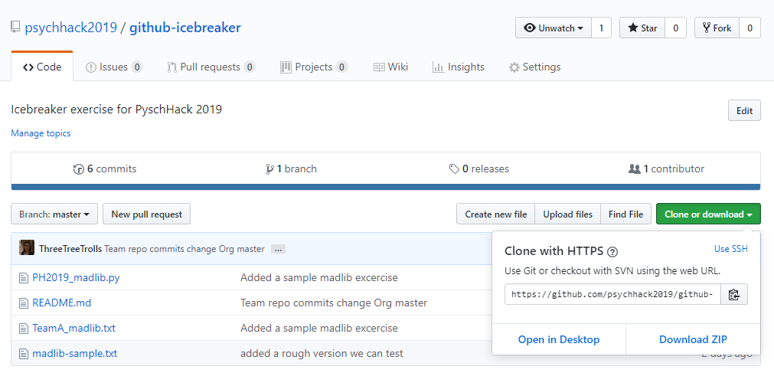
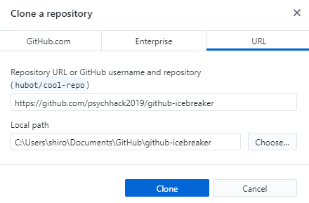
3a. Clone or download a local copy of the repository

Slide 16
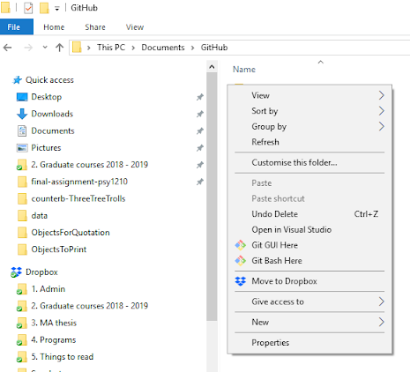
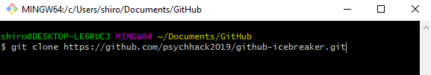
3b. Clone or download a local copy of the repository

Slide 17
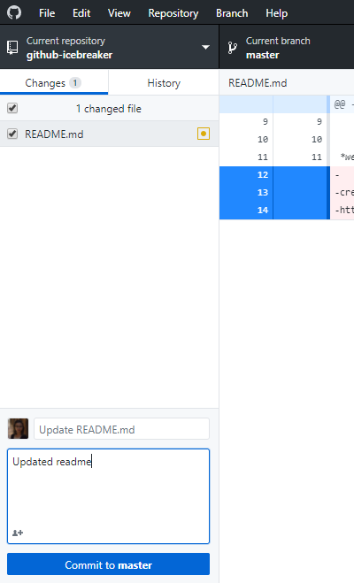
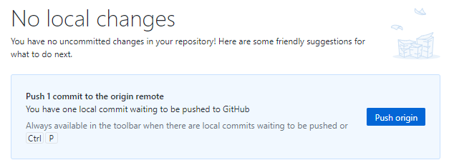
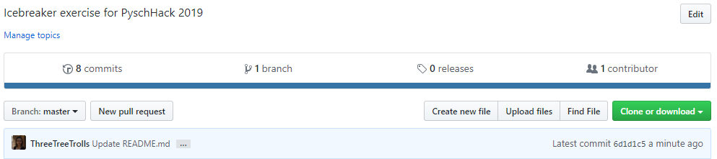
4. Make changes to local files
5a. Commit and push changes to desired branch

Slide 18
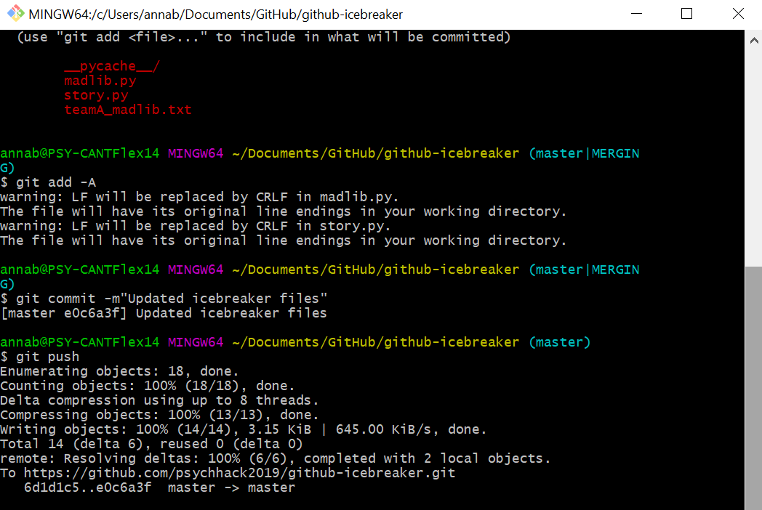
5b. Commit and push changes to desired branch
> git add
> git commit -m “notes”
> git push

Slide 19
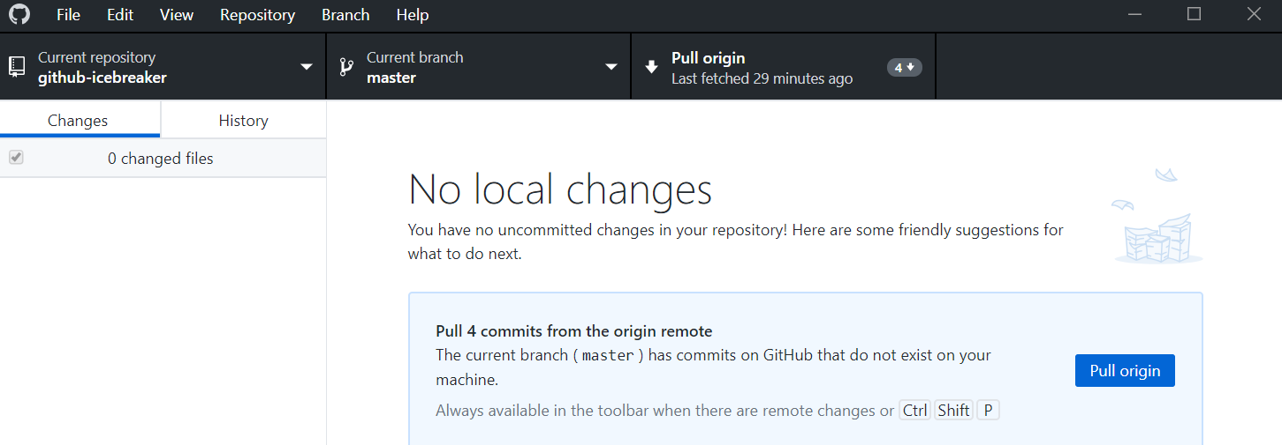
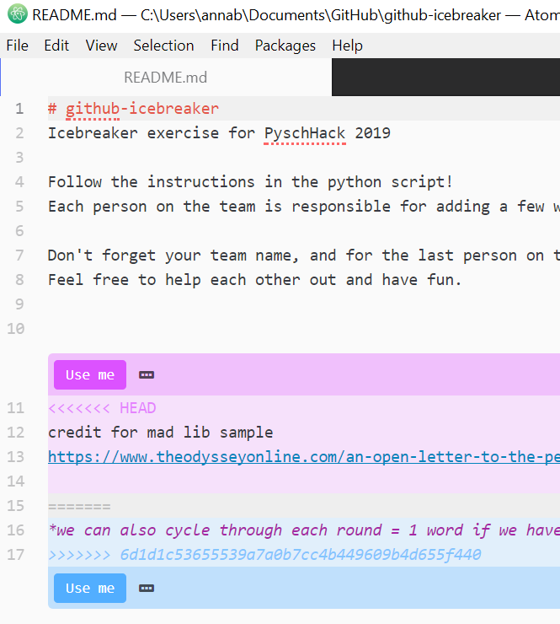
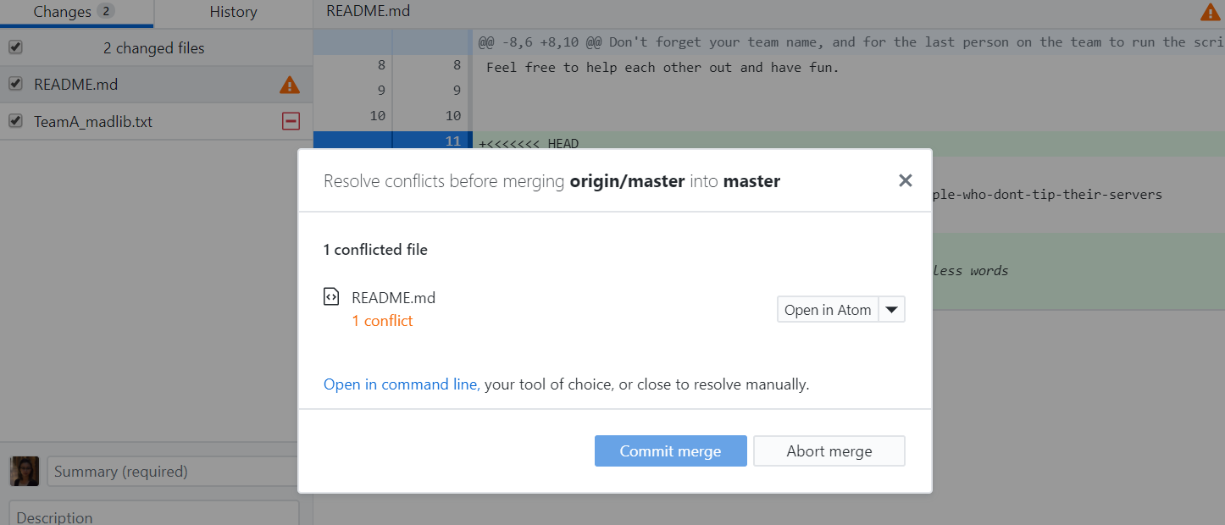
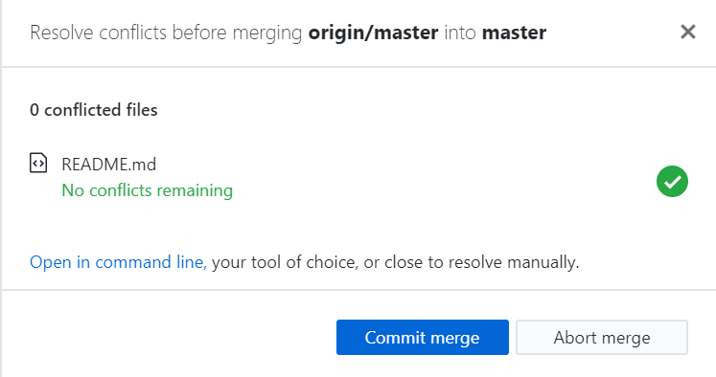
6a. Pull changes from the master
conflicting changes are resolved manually, this can be done using a text editor like Atom

Slide 20
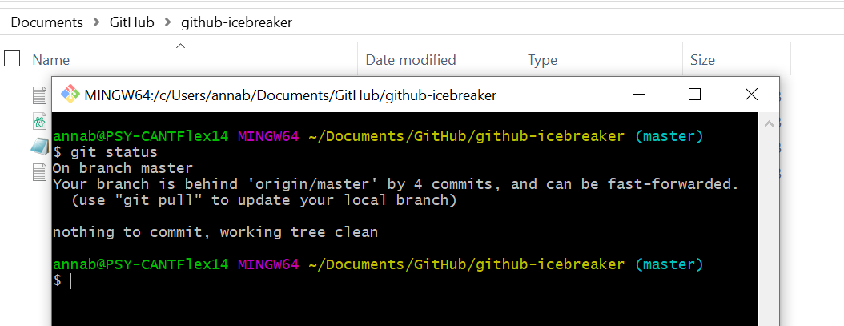
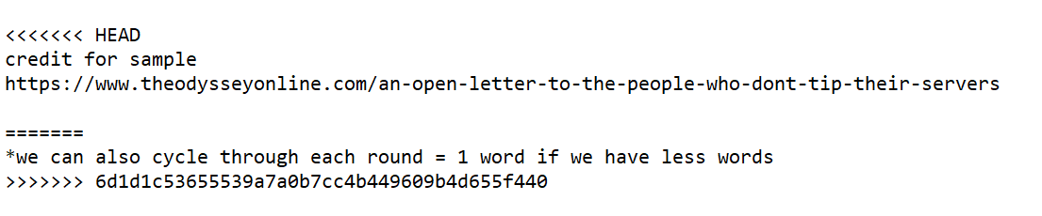

6b. Pull changes from the master
> git status
> git pull
delete conflict markers
make new changes

Slide 21
Madlib relay!
You and your teammates will work together to complete a madlib story
Accept the invitation to the GitHub Classroom assignment and join or create a team
First person on the team makes edits to the file, commits, and pushes their local changes to the remote origin
The next person in the team will pull the changes, and repeat step 2
When your team is done editing madlib.py have the last person run it*
Check that the story text file has been generated successfully
How the relay will work:
person 1: edit, commit, push > person 2: pull, edit, commit, push...
*Last person will need to have python installed

